Slide 1


Bright Coffee Shop
We are here to serve you
IC Vanstad

Slide 2
Agenda
INTRODUCTION
BACKGROUND
ANALYSIS
RECOMMENDATIONS
Q&A

Slide 3
INRODUCTION
Six months of 2023 (January – June) Transactions
The business recorded 149,456 transactions

Slide 4
Background
Store locations
Product Category
Total revenue
New York:
Lower Manhattan,
Hell’s Kitchen,
Astoria.
Coffee
Tea
Drinking Chocolate
Bakery
Flavours
Loose Tea
Coffee beans
Packaged Chocolate
Branded
698812,33

Slide 5
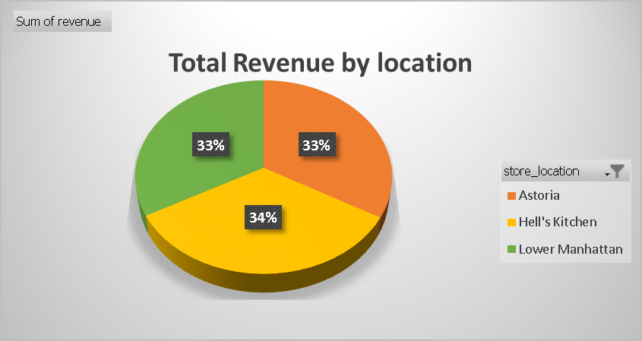
Analysis
Sum of Revenue by Store Location
Astoria R232 243,91
Hell's Kitchen R236 511,17
Lower Manhattan R230 057,25
Grand Total R698 812,33

Slide 6
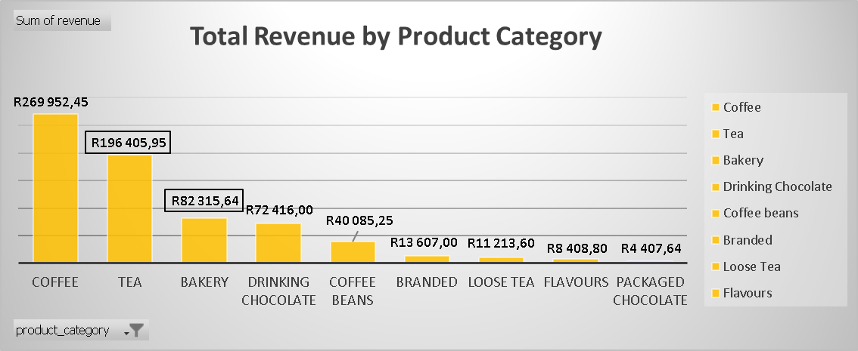
Analysis
Highest to lowest Performing Products by Category:
Coffee
Tea
Bakery
Drinking Chocolate
Coffee beans
Flavours
Branded
Loose Tea
Packaged Chocolate

Slide 7
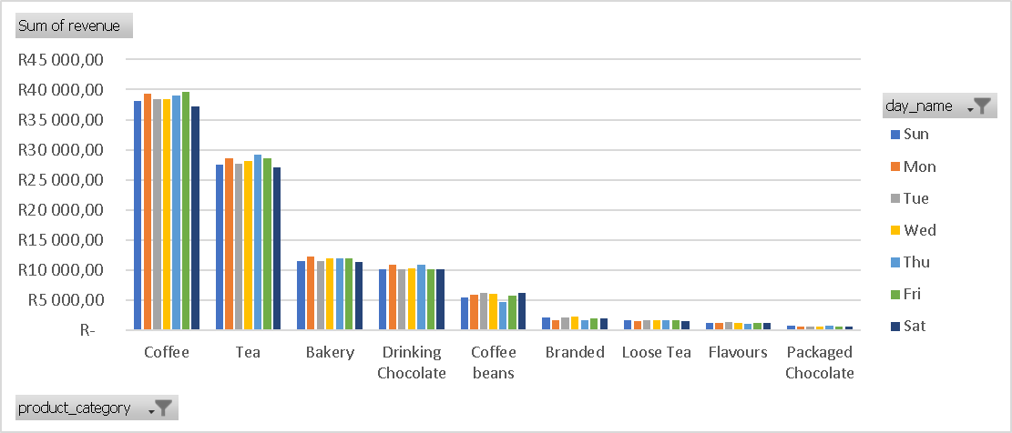
Analysis
Product performance and daily demand:
Coffee is the highest preforming with total Revenue of R269 952,45 especially on Fridays.
The least performing product are Packaged Chocolate making only R4 407,64.

Slide 8
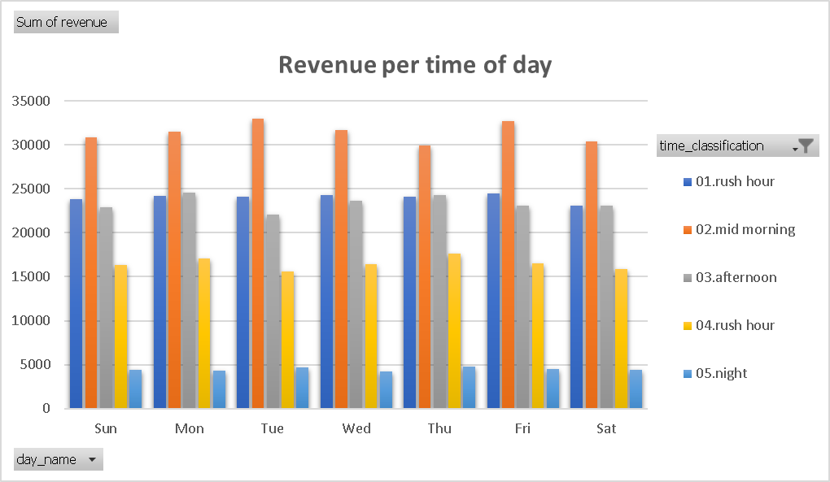
Analysis
Highest to Lowest Performing Time of Day:
Mid morning
Rush Hour 1
Afternoon
Rush hour 2
Night

Slide 9
Recommendations
Focus on High-Revenue Products: Prioritize Coffee by stocking more Barista Espresso & Gourmet.
Optimize Peak Hours: Staff and stock heavily during Mid-Morning & Rush Hour, Run evening promotions to lift slow Night sales
Drive Customer Growth: Launch time-based marketing &Introduce loyalty program for peak-hour customers
Improve Operations: Use 30-minute time buckets for accurate daily forecasting Automate daily sales reports.
Immediate Impact: Grow revenue by focusing 70% effort on Coffee + peak hours.

Slide 10
Q&A

